Slide 1
Feature Importance Analysis for Classification Model
PwC Digital Intelligence Job Simulation
Presented by Pablo Jimenez

Slide 2
Model Overview
- Model Used: Random Forest Classifier
- Dataset: Synthetic (500 samples, 5 features)
- Accuracy: 46%
- Objective: Focus on feature importance rather than model performance

Slide 3
Features Importance Analysis
 | Feature | Importance
0 | Feature_1 | 0.299122
3 | Feature_4 | 0.294907
1 | Feature_2 | 0.290314
4 | Feature_5 | 0.075555
2 | Feature_3 | 0.040101

Slide 4
Global Feature Importance
- Top Features Influencing Classification:
1. Feature_1 (~29.9%)
2. Feature_4 (~29.5%)
3. Feature_2 (~29.0%)
4. Feature_5 (~7.5%)
5. Feature_3 (~4.0%)
- Method Used: RandomForest Built-in Feature Importance

Slide 5
Local Feature Analysis: Observation #4
- Prediction: Class 1 (82% probability)
- Top influencing features:
1. Feature_2
2. Feature_4
3. Feature_1
- Insights: Feature_2 played a major role in classification.

Slide 6
Local Feature Analysis: Observation #20
- Prediction: Class 0 (62% probability)
- Top influencing features:
1. Feature_4
2. Feature_1
3. Feature_2
- Insights: Feature_4 had the strongest impact.

Slide 7
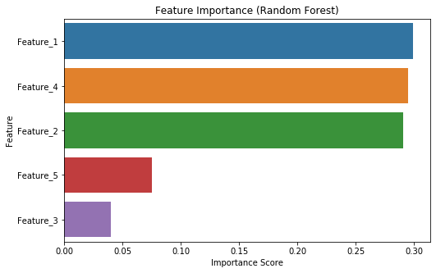
Graph Model Analysis

Slide 8
Key Takeaways
- Feature importance varies at both global and local levels.
01
- Feature_2 is most critical for Observation #4, while Feature_4 dominates for Observation #20.
02
- Feature_3 consistently has the least impact.
03
- Further refinement could enhance interpretability and accuracy.
04

